Slide 1
Computational protein design

Slide 2
Reasons to pursue the goal of protein design
In medicine and industry, the ability to precisely engineer protein hormones and enzymes to perform existing functions under a wider range of conditions, or to perform entirely new functions,
knowledge obtained is likely to be linked to a more complete understanding of the forces underlying protein folding, enabling more rapid interpretation of the wealthof genomic information being amassed.

Slide 3
Current
Currently, attention is focused on redesigning portions of proteins to insert particular motifs, increase stability or modify function.
Example:
Engineering of metal-binding centers
introduction of disulfide bonds

Slide 4
protein design cycle
Energy expression
Atomistic protein design requires an energy expression or force-field to rank the desirability of each amino acid sequence for a particular backbone structure.
Energy minimization
the energy of every possible sequence is calculated using the energy expression, and the lowest energy sequence is reported
Various possibility for the same structure
Search algorithm
mean-field approaches
Monte Carlo techniques
neural networks
genetic algorithms
dead-end elimination
branch-and-terminate
The use of dead end elimination to design the complete sequence for a small protein motif and the use of genetic and mean-field algorithms to design hydrophobic cores for proteins

Slide 5
Discretization of sidechain conformations
This discretization is necessary for some effi-
cient search algorithms to be applicable — in particular,
the dead-end elimination theorem.
Discretization of the sidechain conformations increases the
likelihood of ‘false negative’ results.

Slide 6
Residue classification
A reductionist approach to protein design, in which subsets
of a protein are designed independently, has proven fruit-
ful.

Slide 7
energy expression rele- vant to the core, surface and boundary
The core
When the protein backbone is significantly different from the model backbone, the model can no longer accurately predict the stability of the protein, and there may cease to be a single stable folded state.
The optimal value of α was found to be 90%, implying that a slight over-packing of hydrophobic residues in the core can actually stabilize a designed protein

Slide 8
The surface
With the successful redesign of a range of protein cores, it is
natural to consider the redesign of protein surfaces.
The boundary
Just four boundary-site mutations in the 56-residue
GΒ1 improve the stability from 3.3 kcal/mol to
7.1 kcal/mol at 50°C, converting a mesophilic protein
into a hyperthermophilic protein

Slide 9
Backbone
Most atomistic protein design efforts require a fixed back-
bone. The calculation is performed under the assumption
that the target backbone is precisely the backbone that
will be achieved by the computed sequence. Fortunately,
alterations in the backbone do not necessarily lead to
large changes in the accessible sequence space .

Slide 10
DEE theorum
discrete set of all allowed
conformers of each side-chain, called rotamers.
Residues that form the boundary
between the core and surface require a combi-
nation of the core and the surface scoring func-
tions. The algorithm considers both hydrophobic
and hydrophilic amino acids at boundary pos-
itions, while core positions are restricted to hydro-
phobic amino acids and surface positions are
restricted to hydrophilic amino acids.

Slide 11
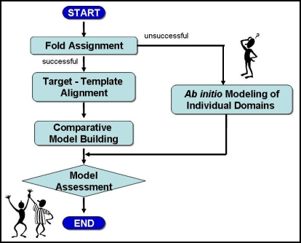

Slide 12
http://www.bmsc.washington.edu/WimHol/

